Slide 1




Beyond the Horizon
The Polish Legacy of 2148

Slide 2





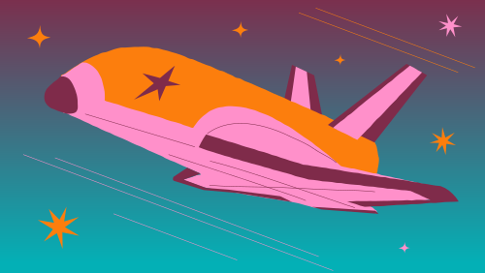
Year 2148. Dr Mikołaj Cieslak of the International Academy of Space Sciences is leading the Pirx mission, aimed at exploring an exoplanet of the same name.
While conducting his research, he realized just how little humanity truly knows about exoplanets.

Slide 3

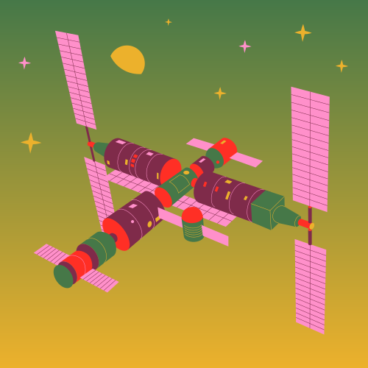

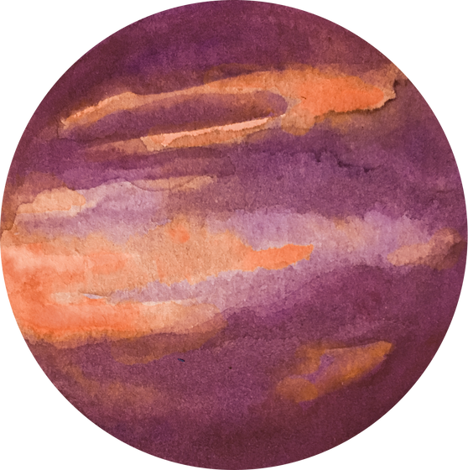
“Beyond the Horizon: The Polish Legacy of 2148” transports players to a future beyond our solar system.
Explore distant planets, conduct experiments
concept art
8-bit exploration mode
Explore far from home planet Pirx, collect and analyze data, survive to expand our understanding of the universe

Slide 4
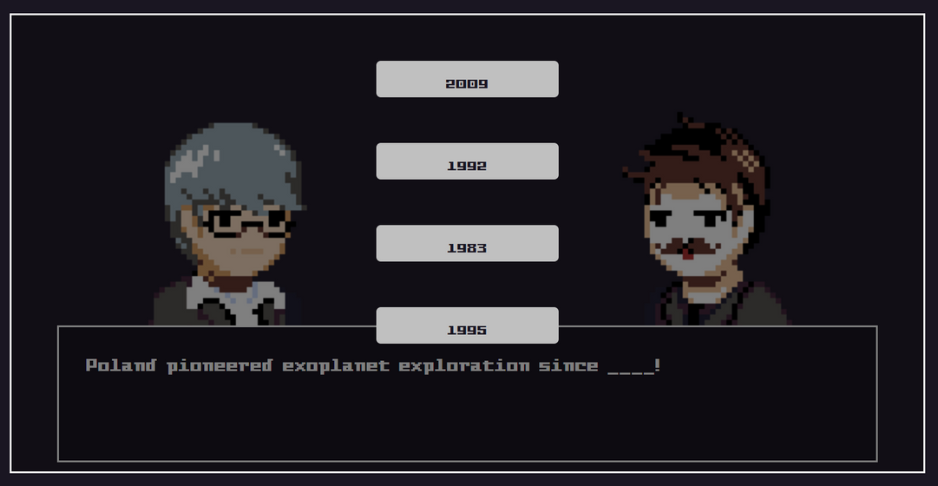
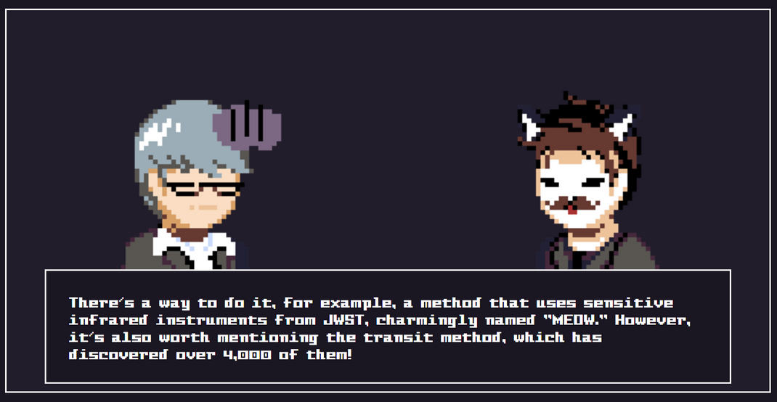
And spread knowledge about the rich history of extraterrestrial exploration
Story mode
Observe work in International Academy of Space Sciences and take part in making history with various interesting personalities.

Slide 5

Play
Learn
Share your knowledge with others!

Slide 6


Created by
Team “Pirx”
May the Earth be a sphere to you!

